Slide 1

MANAGING CONFLICT IN THE CLASSROOM

Slide 2
TRAINING TOPICS
Defining and Understanding Conflict
Strategies to Prevent Classroom Conflict
How to Respond to Conflict in the Classroom
Class Activity
Dealing with Defiant Behavior
The Control Game
Summary and Questions

Slide 3
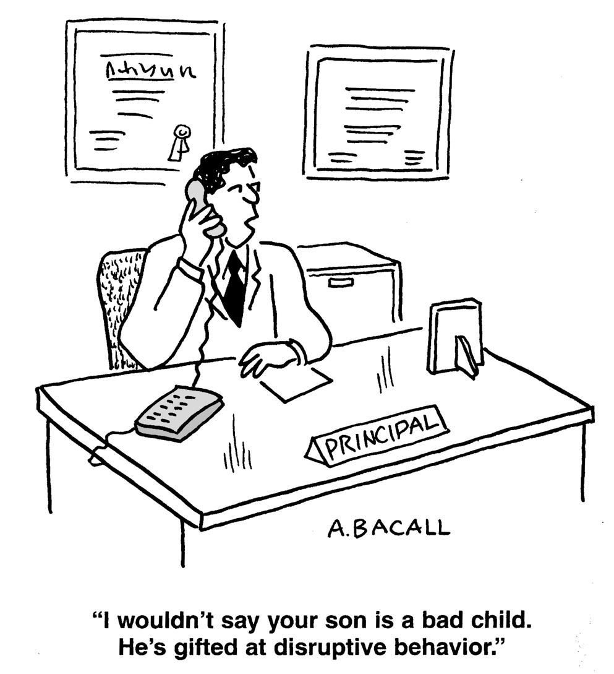

Slide 4
WHAT IS CONFLICT IN THE CLASSROOM?
The intentional behavior of students to disrupt and interfere with the teaching and learning process of others. Thus, conflict can manifest itself in various ways such as student vs. teacher; student vs. student; or even class vs. teacher.

Slide 5

SOME EXAMPLES INCLUDE…
A student who consistently challenges the teachers authority
or knowledge.
A student who
deliberately disrupts
the classroom.
A student who is
impolite or aggressive
towards others in the
classroom.

Slide 6
What are some reasons for the increase in classroom conflict?

Slide 7
SOME THEORIES ABOUT CLASSROOM CONFLICT
Why has classroom conflict become so common? Some theories include:
Greater diversity among the student body.
A larger number of students with emotional issues.
Increased pressure for students to succeed.
Social factors such as gang involvement and increased exposure to violence.

Slide 8

A CLOSER LOOK AT THE PROBLEM
Students are not solely to blame for conflict in the classroom. In some cases teachers can become the
main source of conflict in the classroom.

Slide 9
SOME EXAMPLES INCLUDE…
A teacher who fails to communicate effectively with his or her students is likely to encounter heated disagreements or even disputes during the semester.

Slide 10
EXAMPLES cont.
A teacher who overlooks the importance of establishing a positive learning environment may actually be encouraging students to display resistance during class meetings. Specific examples include: arriving late to class; keeping students past the class period; giving busy work or ungraded assignments; etc.

Slide 11
STRATEGIES FOR PREVENTING CONFLICT
Complete a Class inventory and Self Assessment
What aspects of this class are most likely to be a source of conflict or tension?
How do you usually react too conflict?
What strategies will you use if conflict arises in your classroom?

Slide 12
STRATEGIES FOR PREVENTING CONFLICT
Conduct a Classroom Discussion:
On the first day of class, be sure to spend time discussing your policies and expectations of your students (commitment, workload, assessments, etc.). Have an honest and transparent conversation with your students to ensure everyone is on the same page.

Slide 13
STRATEGIES FOR PREVENTING CONFLICT
Build a Community:
In the first week of class, spend time cultivating a professional relationship with your students. Build rapport and trust with your students through various ice breaker activities. Get to know your students and their interest. Your students will feel more welcome, respected, and motivated to learn by creating a positive learning environment.

Slide 14
STRATEGIES FOR PREVENTING CONFLICT
Model Behavior:
It is crucial that you model appropriate in-class behavior to your students at all times. Students are more likely to follow your lead, (good communication skills, listening, body language, etc.), if you regularly demonstrate it to them.

Slide 15
STRATEGIES FOR PREVENTING CONFLICT
Exercise Empathy:
Recall some of the challenges that you may have faced as a student and be willing to remind yourself of these throughout the semester. By remembering and understanding the students point of view we can often avoid situations that may lead to confrontation.

Slide 16

Responding To Conflict In The Classroom

Slide 17
RESPONDING TO CONFLICT
Listen and Repeat:
When you are dealing with student conflict always listen closely to what is being said and carefully repeat it back to the student. One, you will give yourself the chance to better understand what is frustrating the student. Two, repeating back what you are hearing will help calm the student as the student senses you understand the source of the frustration.

Slide 18

RESPONDING TO CONFLICT
Do Not Ignore It:
When conflict occurs in the classroom it needs to be addressed. Failure to take action often leads to the behavior being repeated in the future. This will not only poison the classroom atmosphere it will also affect the morale of the teacher.

Slide 19
RESPONDING TO CONFLICT
Remain Calm:
Although it is likely to agitate you in some way, avoid reacting in a defensive manner. This response will typically escalate the situation. Instead, try to display patience, respect, and kindness as much as possible to defuse the situation. By remaining calm you ease the anger of the student in the classroom.

Slide 20
RESPONDING TO CONFLICT
Take Action:
Try to resolve the situation in the best possible way. Based on the circumstances, you may want to address the issue at that very moment or you may want to meet with the student after class. Whatever action you decide to take should be done with the goal of de-escalating the situation and maintain a normal classroom environment.

Slide 21
RESPONDING TO CONFLICT
Consult Others:
Depending on the type and pattern of student conflict, you may want to seek advice from fellow faculty members. Teaching styles will vary but experienced teachers may be able to offer some helpful tips for dealing with certain types of conflict in the classroom.

Slide 22

CLASS ACTIVITY

Slide 23

Dealing with Defiant Behavior
Attempt by the student to transfer their angry feelings to the nearest target.
Often viewed as a personal insult by the intervening adult.
Student is
attempting to “push buttons.”

Slide 24
THE CONTROL GAME
Loopholes
Making Deals
Blatant Rule Breaking
Having the Last Word
Questioning “Why?”
Splitting Staff
Refusal to Comply

Slide 25
LOOPHOLES
Attempt by the student to cross the line in the sand that has been drawn by the rule or behavioral expectation.
Correct Response: Must set behavioral expectations up front. Also, very important to set well defined boundaries with these students.

Slide 26
MAKING DEALS
Either / or choice.
Student is stating, “either let me have my way or I will force you into a situation you don’t want.”
Desire to have some sense of control over the situation.
Correct Response: May be lessened by pointing out the control issues at stake. Emphasize the need for consistency with structure and rules.

Slide 27
HAVING THE LAST WORD
Motivated by a need to keep the conversation going so that a sense of control is maintained.
Staff often fall for this trap by responding with their own “last word.”
Correct Response: Be fair but also firm and do not continue the conversation.

Slide 28
BLATANT RULE VIOLATOR
Student is saying, “come and get me.”
Invitation for staff to join the power struggle.
If violation does not threaten safety / security, it can sometimes be ignored (low level behaviors).
Correct Response: Use positive correction techniques and consequence reminders. Also good to remind student about need to comply with rules to achieve future personal goals.

Slide 29
QUESTIONING “WHY?”
Method of controlling discussions.
For legitimate “Why” questions, the rationale should be given.
Correct Response: If question is a challenge to authority, teacher may clarify the issue with the student at a time when it is not convenient for the student (such as during leisure time or recreation time)

Slide 30
PLAYING ONE TEACHER AGAINST ANOTHER
Attack on staff inconsistencies to avoid being responsible for a rule or directive.
Excuse for avoiding behavioral expectations or manipulating a situation.
Correct Response: A simple confrontation of the manipulation is usually the most efficient response.

Slide 31
REFUSAL TO COMPLY
Student is saying, “you can’t make me”
The truth is, staff cannot make them. Only they can decide.
Correct Response: May inform the student this is true, then point out how you hope the student makes a good decision and why. This approach provides an opportunity for the power of choice.

Slide 32

SUMMARY & QUESTIONS

